Slide 1



Slide 2
RECOGNITION
THE MESSIANIC PROPHECY BIBLE PROJECT
http://www.messianicbible.com
HEAR O ISRAEL
www.hearoisrael.org
SHEEPFOLD GLEANINGS WRITTEN BY JULIE PARKER
www.sheepfoldgleanings.com
MESSIANIC ISRAEL ALLIANCE
http://www.messianicisrael.com
AZAMRA TORAH FOR OUR TIME – RABBI AVRAHAM GREENBAUM
http://www.azamra.org

Slide 3
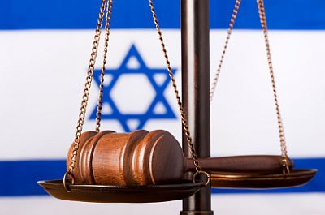
KI’ TETZE “WHEN YOU GO OUT”
TORAH: Deuteronomy 21:10–25:19
HAFTORAH: Isaiah 54:1-10
B’RIT CHADASHAH: 1 Corinthians 5:1-5
All references: The Scripture 1998+ unless otherwise noted

Slide 4
IF YOU GO TO WAR
“When you go out to fight against your enemies, and יהוה your Elohim shall give them into your hand, and you shall take them captive, (Deuteronomy 21:10)
“Ki” or “when” has 4 full pages, with small printing, devoted to it in Gesenius Hebrew-Chaldee Lexicon. However, when used in the context of time, as “when” or “then” it implies that certain things will follow. But, in this context, it also implies the word “if”. It would be like saying, “When, and if, you go out…….. then these things will happen, or this will follow”. It's a foregone conclusion according to יהוה that victory is theirs and with that the prize. There's something conditional going on here, below the surface, only if we go to war do we get the deliverance.
For “enemies”, we have the word “oyvechah” which in English is literally “adversary”. So, “if we go out to war with the adversary and יהוה our Elohim gives him into our hand and we take his captivity captive….”
That is why it says, “When He went up on high, He led captivity captive, and gave gifts to men.” (Ephesians 4:8)

Slide 5
KI TETZEH
In the context of going to war Ki Tetzeh appears to be just a list of random instructions leaping very quickly from one topic to the next with no real logical sequence. One detail, however, jumps out when you consider the parasha in its entirety. Ki Tetzeh is about relationships…between men and women, parents and children, employers and employees, lenders and borrowers, and even between humans and animals. The purpose of this grouping of 74 mitzvot (commandments) is to instruct us in the proper and improper ways of conducting ourselves with others in the daily circumstances of life.
Ki Tetzeh has been described as a definition of “religious commitment”. A person who is passionately in “love” with the Creator is not committed to the commandments because they are the “law”, but he is committed to them because the commandments represent the “will” of the Almighty whom he loves. “Love” expresses itself through obedience:
... to those who love Me and guard My commands. (Deuteronomy 5:10)
" “If you love Me, you shall guard My commands. (John 14:15)

Slide 6
LET YOUR LIGHT SHINE
The Polish rabbi known as the Sefat Emet summed up the reason for “keeping the commandments”, and thereby fulfilling the “will” of יהוה : “The commandments are called ‘candles’, shining light, by the power of Torah, onto every deed. There is no good deed that does not contain some mitzvah (commandment).”
This is exactly what יהושע said!: “Let your light so shine before men, so that they see your good works and praise your Father who is in the heavens. (Matthew 5:16)
When you have “kept a commandment”, the knowledge that you have done the “will” of your Father in heaven will draw you closer to Him. It brings you “joy” in knowing that you have done the right thing. It also encourages you to keep the next commandment. “If you guard My commands, you shall stay in My love, even as I have guarded My Father’s commands and stay in His love. (John 15:10)
Keeping of one commandment leads to the keeping of another commandment, one sin will lead to another sin.

Slide 7
THE FIRST SIN
The first sin can be as simple as an improper thought:
But each one is enticed when he is drawn away by his own desires and trapped. Then, when desire has conceived, it gives birth to sin. And sin, when it has been accomplished, brings forth death. (James 1:14-15)
So we see that our thoughts and our actions have consequences. Whether good or bad, a thought or an action is not an isolated incident. Each one leaves a mark upon our heart that has a real affect on our future. Could this be why this weeks PARSHA concludes with a warning to destroy AMALEK.
“Remember what Amalĕq did to you on the way as you were coming out of Mitsrayim, how he met you on the way and attacked your back, all the feeble ones in your rear, when you were tired and weary. And he did not fear Elohim. “Therefore it shall be, when יהוה your Elohim has given you rest from your enemies all around, in the land which יהוה your Elohim is giving you to possess as an inheritance, that you blot out the remembrance of Amalĕq from under the heavens. Do not forget! (Deuteronomy 25:17-19)

Slide 8
AMALEK
The word “Amaleq” Strong‟s #6002 is from the root word “amal” which means “to be a burden”, “to vex” and “wear down”. If you read the account of the Amaleqite‟s attack on Yisra‟el in Numbers, we see that they attacked first the old, the women and children, those considered the weakest. Their intent was to “wear down” B’nei Yisra’el and defeat them. By including the description of Moshe becoming tired and unable to hold up his own arms, paints the picture of “wearing down”. The numeric value of “Amaleq” is 240 which equals “safeq” or “doubt”. In our own lives, isn’t that what the enemy does to us? He keeps pecking away, wearing us down; trying to get us to drop our arms, let our guard down, to “doubt”. Then, he strikes full force.
240 also equals “patsa” or “wound”. All of these attacks are designed to “wound” you and thus “wear you down”. When you're tired and worn out from the battles of life, perhaps even doubting that you've heard from יהוה at all, then he strikes.
So, as brothers, let's hold up the arms of those under attack; and together, we can defeat the enemy who would destroy us in the wilderness.

Slide 9
AMALEK’S CHARACTER
The following is a paragraph on Amalek’s character from a teaching by Yanki Tauber: “Amalek recognizes his Master and willfully rebels against Him. He acknowledges the existence of G-d, acknowledges G-d’s mastery over him, yet he rebels against Him. Amalek does not deny the truth, or evade the truth, or justify his deeds in any way. He simply challenges the truth, knowing that he will fail, knowing that he will be hurt, driven only by an all-consuming need to assert his independence from G-d.”
Amalek brings to mind people like Haman (book of Esther), Hitler, Osama Bin Laden, Ahmadinejed and groups like Hamas and Al-Qaeda. It is true that the spirit of Amalek is alive in all of these people. This truth is reflected in Shemot:
for he said, “Because a hand is on the throne of Yah, יהוה is to fight against Amalĕq, from generation to generation.” (Exodus 17:16)

Slide 10
TAKING PRISONERS
“When you go out to fight against your enemies, ... and you shall take them captive, and shall see among the captives a woman fair of form, and shall delight in her and take her for your wife, then you shall bring her home to your house, and she shall shave her head and trim her nails, and put aside the mantle of her captivity, and shall dwell in your house, and mourn her father and her mother a month of days. And after that you shall go in to her and be her husband, and she shall be your wife. “And it shall be, if you are not pleased with her, then you shall let her go at her desire, but you do not sell her at all for silver. Do not treat her harshly, since you have humbled her. (Deuteronomy 21:10-14)
Specifically, what is being referenced is an optional war outside of the land, since war instructions for conquering the land would not allow the taking of any captives:
“Only, of the cities of these peoples which יהוה your Elohim gives you as an inheritance, you do not keep alive any that breathe, (Deuteronomy 20:16)
Note: She is totally free if she is found not acceptable.

Slide 11
CAPTIVE WOMAN
יהוה understands human nature and the evil inclination (which drives him to lust). יהוה knew that even if the Torah forbade Israelite men from marrying captive women, they would do it anyway. Therefore, instead of being able to take her illicitly, יהוה sets forth limits which are meant to cool down the fire of passion and therefore give him time to make a sensible decision.
For the woman, the opportunity to become the wife of an Israelite is likely a far better fate than that awaiting the other female captives. This woman captive is protected by a man who must consider her future. If he does not desire her, than she cannot become enslaved.
In wartime’s gentile maidens would adorn themselves so that they could seduce the enemy to follow their own pagan faith. The captive’s hair, her nails, and her clothing identified her as a member of her former culture, so by changing them she is given the opportunity for a fresh start. During the month of mourning, every time the man enters his house he will see her weeping and also see her unattractive appearance…all forcing him to look beyond his initial attraction to her.

Slide 12
SEEING THE EVIL WOMAN
The idea is to not see the woman captive, not as a victim, but rather as behaving in the manner of the evil woman of whom Proverbs warns us to beware:
To guard you against the strange woman, Against the foreigner who flatters with her words. For at the window of my house I looked through my lattice, And I saw among the simple, I perceived among the youths, A young man lacking heart, Passing through the street near her corner; And he went the way to her house In the twilight, in the evening, In the black and dark night. And look, a woman met him, Dressed like a whore, With a hidden heart. She was boisterous and stubborn, Her feet did not stay at her own house. Now in the street, Now in the square, And at every corner she lurks. And she took hold of him and kissed him; She hardened her face and said to him: “Peace offerings are with me; Today I have paid my vows. “Therefore I came out to meet you, To earnestly seek your face, and I found you. “I have spread my bed with coverings, Coloured linens of Mitsrayim. “I have sprinkled my bed with myrrh, aloes, and cinnamon. (Proverbs 7:5-17)

Slide 13
GODLY WOMEN
Men tend to be drawn to the outward appearance of women. Therefore, godly women are instructed to present themselves modestly:
Likewise, that the women dress themselves becomingly, with decency and sensibleness, not with braided hair or gold or pearls or costly garments, but with good works, which is becoming for women undertaking worship of Elohim. (1 Timothy 2:9-10)
If the woman is willing to change her identity from a foreigner to an Israelite, this is an awesome opportunity for her. It also is a picture of what we are required to do as the “lost sheep of the tribe of Israel” as we cut ties with “Egypt” and join the family of Israel. יהושע communicated this to those choosing to become a member of His Kingdom: יהושע said, “Truly, I say to you, there is no one who has left house or brothers or sisters or father or mother or wife or children or lands, for the sake of Me and the Good News, who shall not receive a hundredfold now in this time, houses and brothers and sisters and mothers and children and lands, with persecutions, and in the age to come, everlasting life. (Mark 10:29-30)

Slide 14
FIRSTBORN
“When a man has two wives, one loved and the other unloved, and they have borne him children, both the loved and the unloved, and the first-born son is of her who is unloved, then it shall be, on the day he makes his sons to inherit his possessions, he is not allowed to treat the son of the beloved wife as first-born in the face of the son of the unloved, who is truly the first-born. “But he is to acknowledge the son of the unloved wife as the first-born by giving him a double portion of all that he has, for he is the beginning of his strength – the right of the first-born is his. (Deuteronomy 21:15-17)
There was a very real possibility that when the soldier brought home the captive woman, she may have been his first wife. This would likely mean that she would have the firstborn son. If his main reason for marrying her was a physical attraction, she could easily have become the less favoured wife. Throughout the Scriptures we see the apparently common occurrence that in a polygamous situation, one wife is loved and the other hated. Just like יהוה made allowance for man’s lust with the captive woman, He continues to provide for her child because He is a loving Elohim.

Slide 15
POLYGAMY
These verses ARE NOT TO BE USED as evidence that polygamy was endorsed by Scripture. Torah consistently provides solutions for our less than perfect choices. יהוה hates divorce. Yet He makes allowances for divorce. Allowances are not the same as endorsements or approvals. Marriage should be a visible revelation of the covenant that יהוה made with Israel….and also of the ultimate relationship that יהושע will have with His ONE bride:
An overseer, then, should be blameless, the husband of one wife, sober, sensible, orderly, kind to strangers, able to teach, (1 Timothy 3:2)
Let attendants be the husbands of only one wife, ruling children and their own houses well. (1 Timothy 3:12)
if anyone is unreprovable, the husband of one wife, having believing children not accused of loose behaviour, or unruly. (Titus 1:6)

Slide 16
REBELLIOUS SON
“When a man has a wayward and rebellious son who is not listening to the voice of his father or the voice of his mother, and who, when they have disciplined him, does not listen to them, then his father and his mother shall take hold of him and bring him out to the elders of his city, to the gate of his city, and shall say to the elders of his city, ‘This son of ours is wayward and rebellious. He is not listening to our voice, he is a glutton and a drunkard.’ “Then all the men of his city shall stone him to death with stones. Thus you shall purge the evil from your midst. And let all Yisra’ĕl hear, and fear. (Deuteronomy 21:18-21)
This is not your ordinary child. According to many of the sages, this son is of an age of accountability (20) and is still living under the roof of his parents, albeit without the authority of Torah. As a last resort, these powerless parents bring him out to be judged by the elders of the city. The reason given for this was because “they must put away the evil from among them”. The good of the whole nation was more important than individual family ties. The result would be that Israel would “hear and fear”….the exact attributes that were missing in the rebellious son.

Slide 17
יהוה
The son was charged with being stubborn, rebellious, a glutton, and a drunkard. יהוה considers these to be very serious charges. For example, rebellion is rejection of the Word of יהוה!
QUESTION: If your child committed murder would you turn him in to the authorities?
In this situation, יהוה has commanded that if you have a child that you have done everything you can to rehabilitate with no result, then you must turn them over to be judged. The good of the whole nation was more important than individual family ties. The result would be that Israel would “hear and fear”, the exact attributes that were missing in the rebellious son.
Now we know that today, this commandment cannot be applied in our culture. And it is interesting that there is no historic record that it EVER was applied. Think a moment, however, what we have today. We have laws that often favour children over parents. There are laws that do not allow you to properly discipline your children. These laws punish parents who are attempting to keep their children from being stubborn, rebellious, gluttons and drunkards.

Slide 18
CURSED
“And when a man has committed a sin worthy of death, then he shall be put to death and you shall hang him on a tree. “Let his body not remain overnight on the tree, for you shall certainly bury him the same day – for he who is hanged is accursed of Elohim – so that you do not defile the land which יהוה your Elohim is giving you as an inheritance. (Deuteronomy 21:22-23)
Before you cast the first stone, ask yourself if you have been a “wayward” son or daughter? This is a description of each of us before we came to the Messiah for salvation. WE were the ones deserving of death. WE were the ones cursed by Elohim. Yet, as Torah has taught us over and over again, there is the way of substitution. יהושע took on all of our rebellion and died in our place. He assumed the curse of the Torah (which is the penalty of death in both the sense of physical death and spiritual separation from the Almighty) due us:
Messiah redeemed us from the curse of the Torah, having become a curse for us – for it has been written, “Cursed is everyone who hangs upon a tree.” (Galatians 3:13)
The word for “hang” in Deuteronomy 21:22 is the word tallit, like the prayer shawl that hangs over one’s shoulders……

Slide 19
CRUCIFICTION
Britannica reports that the first historical record of Crucifixion was about 519 BC when "Darius I, king of Persia, crucified 3,000 political opponents in Babylon" (Encyclopaedia Britannica, crucifixion)
Some further detail is given in "The Eerdman's Bible Dictionary", Rev. Ed., 1975: CROSS ... Crucifixion is first attested among the Persians (cf. Herodotus, Hist. i.128.2; iii.132.2, 159.1), perhaps derived from the Assyrian impalement. It was later employed by the Greeks, especially Alexander the Great, and by the Carthaginians, from whom the Romans adapted the practice as a punishment for slaves and non-citizens, and occasionally for citizens guilty of treason. Although in the Old Testament the corpses of blasphemers or idolaters punished by stoning might be hanged "on a tree" as further humiliation (Deut. 21:23), actual crucifixion was not introduced in Palestine until Hellenistic times. The Seleucid Antiochus IV Epiphanes crucified those Jews who would not accept hellenization (Josephus Ant. xii.240-41; cf 1 Macc. 1:44-50).

Slide 20
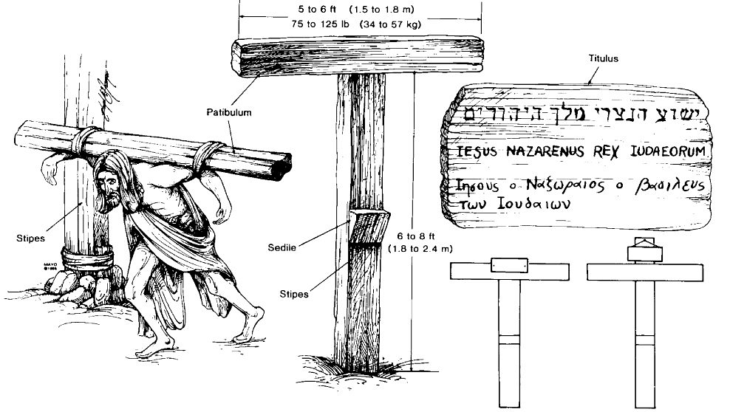
HISTORY
Historical findings have substantiated the traditional cross. One finding is a graffito dating to shortly after 200 A.D., taken from the walls of the Roman Palatine. It is a drawing of a crucified ass; a mockery of a Christian prisoner who worships Christ. The Romans were no doubt amused that Christians worshiped this Jesus whom they had crucified on a cross.
At the end of the first century B.C., the Romans adopted crucifixion as an official punishment for non-Romans for certain limited transgressions. Initially, it was employed not as a method of execution, but only as a punishment. Moreover, only slaves convicted of certain crimes were punished by crucifixion. During this early period, a wooden beam, known as a furca or patibulum was placed on the slave's neck and bound to his arms.
If the victim was attached by nails, he was laid on the ground, with his shoulders on the crossbeam. His arms were held out and nailed to the two ends of the crossbeam, which was then raised and fixed on top of the vertical beam. The victim's feet were then nailed down against this vertical stake.

Slide 21
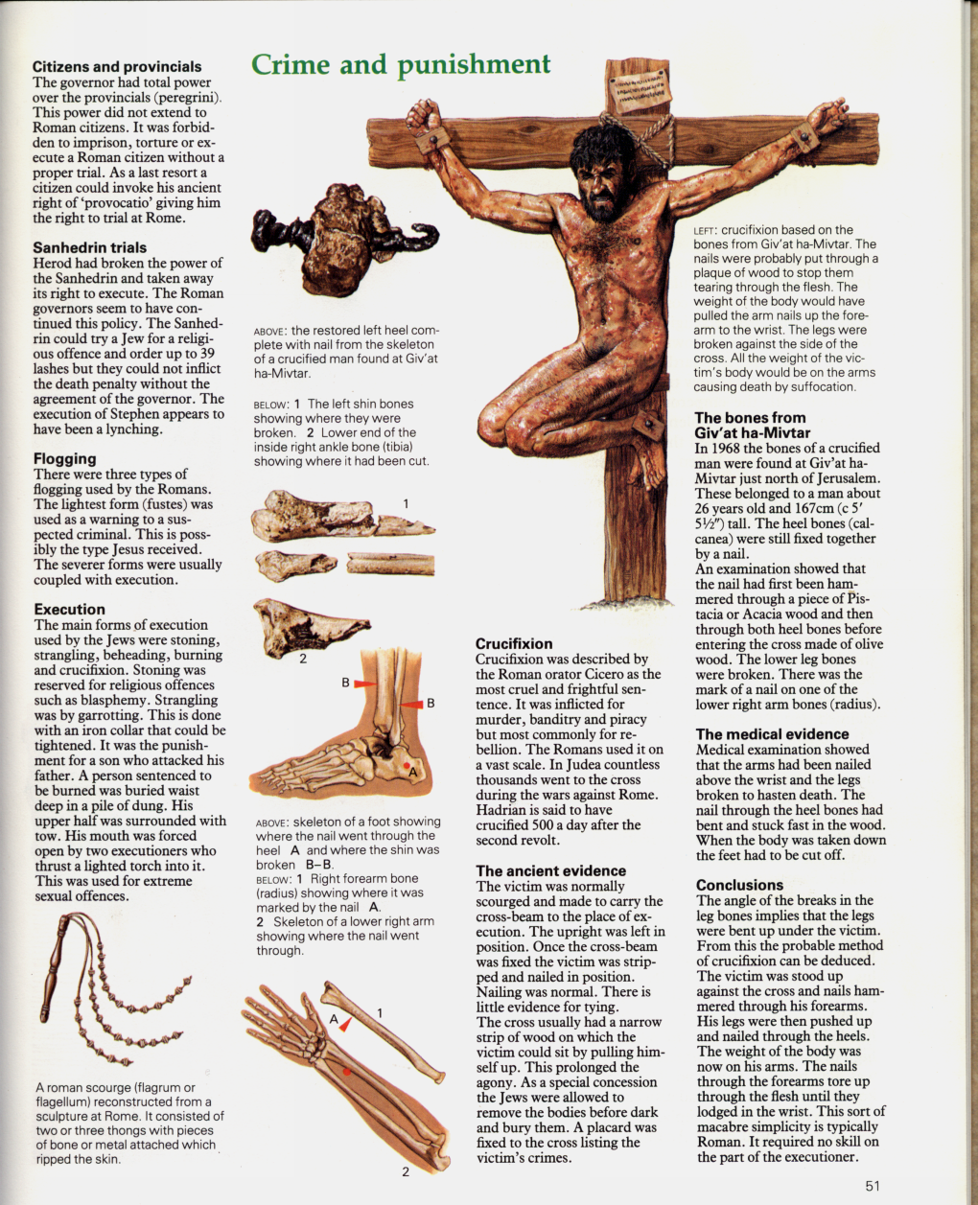
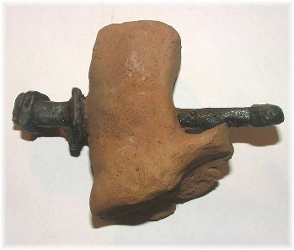
NAILS IN THE HEEL
An archaeological find giving unique historical evidence about death by crucifixion in the time of יהושע. The heel bone (the calcenaeum - the largest bone in the foot) of a crucified man pierced with an iron nail.

Slide 22
HISTORY CON’T
In order to prolong the agony, Roman executioners devised two instruments that would keep the victim alive on the cross for extended periods of time. One, known as a sedile, was a small seat attached to the front of the cross, about halfway down. This device provided some support for the victim's body and may explain the phrase used by the Romans, "to sit on the cross." Both Eraneus and Justin Martyr describe the cross of Jesus as having five extremities rather than four; the fifth was probably the sedile. (p. 48,49)
In a follow up article on this archaeological find in the Nov/Dec. issue of BAR, the statement is made: According to the (Roman) literary sources, those condemned to crucifixion never carried the complete cross, despite the common belief to the contrary and despite the many modern re-enactments of Jesus' walk to Golgotha. Instead, only the crossbar was carried, while the upright was set in a permanent place where it was used for subsequent executions. As the first-century Jewish historian Josephus noted, wood was so scarce in Jerusalem during the first century A.D. that the Romans were forced to travel ten miles from Jerusalem to secure timber for their siege machinery. (p. 21)

Slide 23
SHAPE OF THE CROSS
And Pilate wrote a title too, and put it on the stake, and it was written: יהושע OF NATSARETH, THE SOVEREIGN OF THE YEHUḎIM. (John 19:19)
You get two types of crosses namely:
crux immissa (+) or
crux commissa (T).
As it was NOT very common to affix a titlos (superscription, loanword from the Lat. titulus), it does not necessarily follow that the cross had the form of a crux immissa.

Slide 24
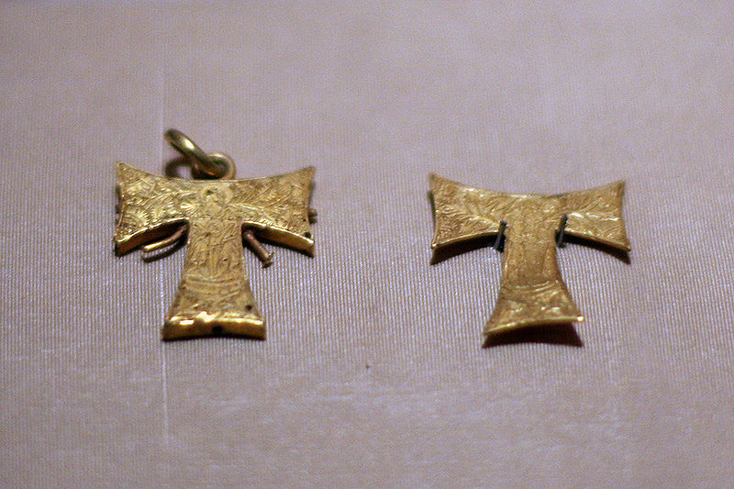

TAU CROSS (From Wikipedia)
The Cross of Tau, named after the Greek letter it resembles, is a form of the Christian cross symbol. It is also variously St. Anthony's Cross, Old Testament Cross, Anticipatory Cross, Cross Commissee, Egyptian Cross, Advent Cross, Croce taumata, Saint Francis's Cross, Crux Commissa.[citation needed]
The shape of the letter tau or T was interpreted as representing a crucifix from antiquity. The staurogram, from Greek ΣTAΥPOΣ "cross", was a tau-rho ligature used to abbreviate the Greek word for cross in very early New Testament manuscripts such as P66, P45 and P75. The tau was also considered a symbol of salvation due to the identification of the tau with the sign which in Ezekiel 9:4 was marked on the forehead of the saved ones, or due to the tau-shaped outstretched hands of Moses in Exodus 17:11.
And it came to be, when Mosheh held up his hand, that Yisra’ĕl prevailed. And when he let down his hand, Amalĕq prevailed. (Exodus 17:11)

Slide 25
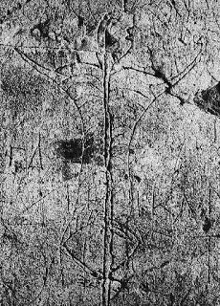
TAU
In ancient times, Tau was used as a symbol for life and/or resurrection, whereas the eighth letter of the Greek alphabet, theta, was considered the symbol of death.
In Biblical times, the Taw was put on men to distinguish those who lamented sin, although newer versions of the Bible have replaced the ancient term “Taw” with "mark" (Ezekiel 9:4) or "signature" (Job 31:35).
Found in Puzzuoli, Italy this graffiti image of a crucified man demonstrates crucifixion on a "Tau" cross shaped like our capital "T". Some describe all the markings as scourging, but could also be the image of the ribs around the thorax area with scourging continuing further down. The feet appear nailed at the ankles to either side of the upright.
Http://www.bible.ca/d-history-archeology-crucifixion-cross.htm

Slide 26
HANDS or WRISTS
Grammatically, the New Testament does not use a Greek word specifically for wrists. The Greek word cheir can refer to the hand or wrist. The Latin Vulgate uses manus in Luke 24:40, specifically referring to hands, indicating that this interpretation dates at least to the second century.
Medically speaking, studies have shown that a nail through either hands or wrists would be strong enough to hold a person to a cross. In fact, it has been said the conjunctive tissue in the hand is stronger than a rope.
The strongest case could be made by a look at the Jewish prophecies and traditions related to יהושע the Messiah. In the Old Testament, one important prophecy related to the Messiah is relevant.
For dogs have surrounded Me; A crowd of evil ones have encircled Me, Piercing My hands and My feet; (Psalms 22:16)
The specific Hebrew word for hands is used here, referring too:
“See My hands and My feet, that it is I Myself. Handle Me and see, for a spirit does not have flesh and bones as you see I have.” And saying this, He showed them His hands and His feet. (Luke 24:39-40)

Slide 27
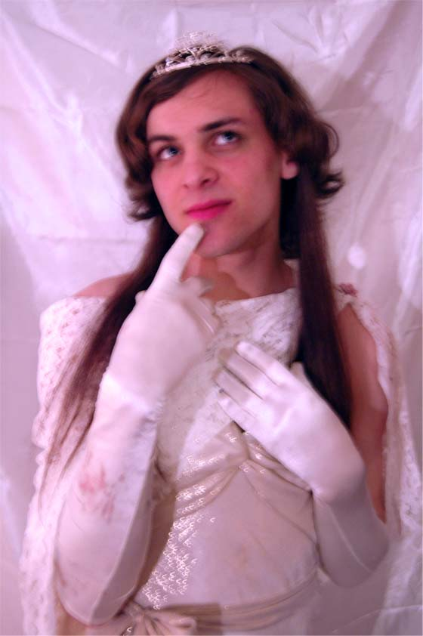
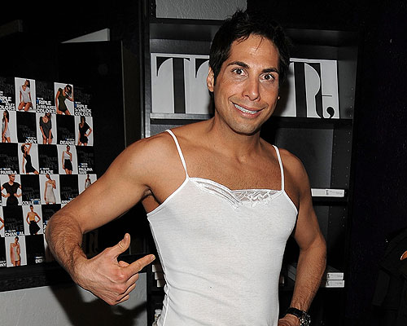
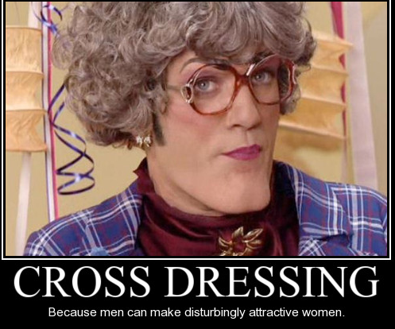
ILLICIT MIXTURES
The following grouping of commandments is commonly called “illicit mixtures”.
“A woman does not wear that which pertains to a man, nor does a man put on a woman’s garment, for whoever does this is an abomination to יהוה your Elohim. (Deuteronomy 22:5)
It is an abomination to יהוה to deviate from the order that He has set for His creation.
Illicit mixtures are associated with the 7th commandment, the law against adultery. What is adultery? It is simply an illicit mixture!
Anytime we have a mixture of the pure with the impure, or the holy with the unholy, we have an illicit mixture that physically demonstrates a spiritual principle. It’s in obeying the physical commandment that we learn the spiritual principle.

Slide 28
DEFILING THE FIELD
“Do not sow your vineyard with different kinds of seed, lest the yield of the seed which you have sown and the fruit of your vineyard be defiled. (Deuteronomy 22:9)
The first law forbids the sowing of different seeds in a vineyard. When different plant species are planted in close proximity to each other, their roots intermingle and each derives nourishment from the other. The result is a hybrid – a plant that has integrated into itself the characteristics of another species. The SEED has been intrinsically altered…perhaps its taste, texture, and other qualities affected by the fact that it shared soil with a different species. If we mix the seed, the fruit we produce will not become the true “wine” of יהוה. יהוה has a vineyard, that must not be defiled:
For the vineyard of יהוה of hosts is the house of Yisra’ĕl, and the man of Yehuḏah is His pleasant plant. He looked for right-ruling, ..(Isaiah 5:7)
Luke 8:11 tells us that the seed is the Word of יהוה. Therefore, it is very easy to understand that the Almighty wants no mixing of His Word with any other word in His vineyard, Israel!

Slide 29
XO AND DONKEY
“Do not plough with an ox and a donkey together. (Deut 22:10)
These animals will have to alter their WALK in order to plow the field together and this is what יהושע was referring to when He said:
“Come to Me, all you who labour and are burdened, and I shall give you rest. “Take My yoke upon you and learn from Me, for I am meek and humble in heart, and you shall find rest for your beings. “For My yoke is gentle and My burden is light.” (Matthew 11:28-30)
The ox and the donkey are also a picture of mixing the clean with the unclean. The ox is the highest form of offering, while a donkey is associated with the world. Paul elaborates on this idea:
And what agreement has Messiah with Beliyaʽal? Or what part does a believer have with an unbeliever? And what union has the Dwelling Place of Elohim with idols? For you are a Dwelling Place of the living Elohim, as Elohim has said, “I shall dwell in them and walk among them, and I shall be their Elohim, and they shall be My people.” Therefore, “Come out from among them and be separate, says יהוה, and do not touch what is unclean, and I shall receive you. (2 Corinthians 6:15-17)

Slide 30
WOOL AND LINEN
“Do not put on a garment of different kinds, of wool and linen together. (Deuteronomy 22:11)
Josephus offers the suggestion that the prohibition relates to the fact that the High Priest wore this combination; therefore a similar weave was not to be used by the common man. This is similar to the holy anointing oil which was not to be duplicated by the common Israelite.
Illicit mixing is the reason why we have strayed so far from the Torah. After the ascension of יהושע, the fledgling congregations began to mix יהוה’s Torah with pagan practices. Very quickly this led to the abandonment of Shabbat. Pesach was replaced by Easter worship and the birth of the Messiah became associated with a variety of pagan rituals centered on the sun and the winter solstice. Today, many believers desire to rid themselves of the mixing that we have “inherited” and become obedient to the concept of holiness:
as obedient children, not conforming yourselves to the former lusts in your ignorance, instead, as the One who called you is set-apart, so you also should become set-apart in all behaviour, because it has been written, “Be set-apart, for I am set-apart.” (1 Peter 1:14-16)

